Slide 1
Project Management
CT050-3-3-PRMGT
07: Planning Projects
Part 4 - Stakeholder, Risk & Procurement

Slide 2
Topic & Structure of The Lesson
Knowledge area | Planning process | Outputs
Project risk management | Plan risk management Identify risks Perform qualitative risk analysis Perform quantitative risk analysis Plan risk responses | Risk management plan Risk register Risk report Project documents updates Change requests Project management plan updates Project documents updates
Project procurement management | Plan procurement management | Procurement management plan Procurement strategy Bid documents Procurement statement of work Source selection criteria Make or buy decisions Independent cost estimates Change requests Project documents updates Organizational process assets updates
Project stakeholder management | Plan stakeholder engagement | Stakeholder engagement plan

Slide 3
Learning Outcomes
At the end of this topic, You should be able to
List several planning processes and outputs for stakeholder, risk, and procurement management
Understand the importance of planning stakeholder engagement, and describe the contents of a stakeholder engagement plan
Discuss the five project risk management planning processes, and explain how a risk management plan, a risk register, and change requests are used in risk management planning
Discuss the project procurement management planning process, and describe several outputs including a procurement management plan, source selection criteria, and make-or-buy decisions

Slide 4
Key Terms You Must Be Able To Use
If you have mastered this topic, you should be able to use the following terms correctly in your assignments and exams:
probability/impact matrix
risk response strategies
risk register, risk report
RFI/RFP/RFQ
bid documents
procurement statement of work
source selection criteria
make-or-buy decisions
independent cost estimates

Slide 5
Project Stakeholder Management
Project stakeholder management planning involves determining strategies to effectively engage stakeholders in project decisions and activities based on their needs, interests, and potential impact.
The main output of this process is a stakeholder engagement plan.
The stakeholder engagement plan, the communications management plan, and the resource management plan are tightly bound and should be in agreement.

Slide 6
Stakeholder Engagement Plan Contents
Current and desired engagement levels of key stakeholders
Scope and impact of change to stakeholders
Identified interrelationships between stakeholders and potential overlap
Potential management strategies for each stakeholder classification
Methods for updating the stakeholder management plan
Note: Some information may be confidential, so it should have limited distribution.

Slide 7
Sample Stakeholder Engagement Plan
Name | Power/ Interest | Current engagement | Potential Management Strategies
Mike Sundby | High/high | Supportive | Mike is very outgoing and visionary. Great traits for a project champion. He is concerned about financials and has an MBA. Manage closely and ask for his advice as needed. Schedule short face-to-face meetings as needed.
Lucy Camerena | High/high | Leading | Lucy has a Ph.D. in education and knows training at this company. She is very professional and easy to work with, but she can stretch out conversations. Make sure she reviews important work before showing it to other managers.
Ron Ryan | Low/ medium | Resistant | Ron led the Phase I project and is upset that he was not asked to lead this Phase II project. He’s been with the company over 20 years and can be a good resource, but he could also sabotage the project. Ask Lucy to talk to him to avoid problems. Perhaps give him a small consulting role on the project.

Slide 8
Project Risk Management
PMI defines a project risk as an uncertainty that can have a negative or positive effect on meeting project objectives
Note that some people only view risks as negative and call positive risks opportunities
The main planning processes are planning risk management, identifying risks, performing qualitative risk analysis, performing quantitative risk analysis, and planning risk responses
You can also plan to reduce procurement-related risks by making risk-related contract decisions

Slide 9
Project Risk Management
A risk management plan documents the procedures for managing risk throughout the life of a project
The general topics that a risk management plan should address include the methodology for risk management, roles and responsibilities, budget and schedule estimates for risk-related activities, risk categories, probability and impact matrices, and risk documentation

Slide 10
Other Risk Plans
Contingency plans are predefined actions that the project team will take if an identified risk event occurs
Fallback plans are developed for risks that have a high impact on meeting project objectives, and are put into effect if attempts to reduce the risk are not effective; sometimes called contingency plans of last resort
Contingency reserves or contingency allowances are funds held by the project sponsor that can be used to mitigate cost or schedule overruns if known risks occur
Management reserves are funds held for unknown risks that are used for management control purposes – not part of the cost baseline, but are part of the project budget and funding requirements

Slide 11
Identifying Risks
You cannot manage risks until you identify them
Identifying risks involves determining which risks are likely to affect a project and documenting the characteristics of each
The main outputs of this process are a risk register and a risk report

Slide 12
Risk Events
Risk events refer to specific, uncertain events that may occur to the detriment or enhancement of the project
Negative risk events include the performance failure of a product produced as part of a project, delays in completing work as scheduled, increases in estimated costs, supply shortages, litigation against the company, and strikes
Positive risk events include completing work sooner than planned or at an unexpectedly reduced cost, collaborating with suppliers to produce better products, and obtaining good publicity from the project
You can chart the probability and impact of risk events on a matrix

Slide 13
Overall Project Risk
Overall project risk is the effect of uncertainty on the project as a whole
Contents of a risk report include sources of overall project risk and summary information on risk events, such as number of risks, distribution across risk categories, metrics, and trends
The risk report is developed progressively during the entire risk planning processes

Slide 14
Performing Qualitative Risk Analysis
Results in prioritizing risks as high, medium, or low
A probability/impact matrix is a good technique to help decide which risks are most important on a project

Slide 15
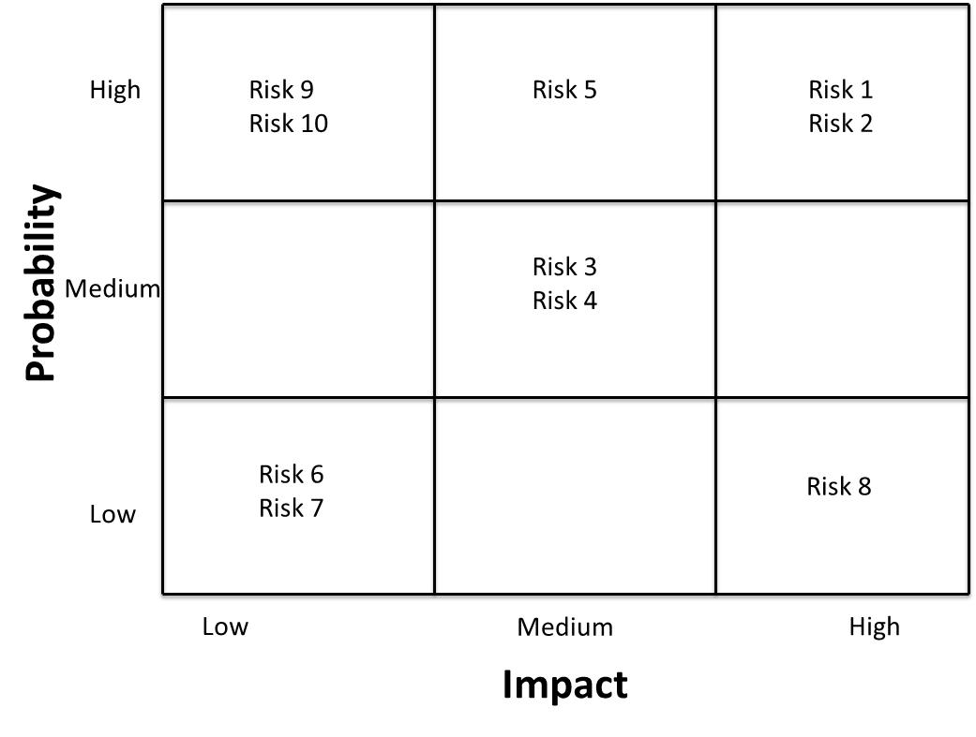
Sample Probability/Impact Matrix

Slide 16
Performing Quantitative Risk Analysis
Large, complex projects involving leading-edge technologies often require extensive quantitative risk analysis
Data gathering often involves interviewing experts and collecting probability distribution information
Quantitative risk analysis and modeling techniques include decision tree analysis, simulation, influence diagrams, and sensitivity analysis. The most commonly used simulation tool is Monte Carlo analysis.

Slide 17
Planning Risk Responses
Negative risk responses
Escalation of the risk
Risk avoidance
Risk acceptance
Risk transference
Risk mitigation
Positive risk responses
Escalation of the risk
Risk exploitation
Risk sharing
Risk enhancement
Risk acceptance

Slide 18
Risk Registers
A risk register is a document that contains the results of various risk management processes and is often displayed in a table or spreadsheet format
It is a tool for documenting potential risk events and related information, including:
An identification number for each risk event
A rank for each risk event (usually high, medium, or low)
The name of the risk event
A description of the risk event
The category under which the risk event falls
The root cause: The real or underlying reason a problem occurs
Triggers: Indicators or symptoms of actual risk events
Potential responses to each risk event
The risk owner, or person who will own or take responsibility
The probability of the risk event occurring
The impact to the project if the risk event occurs
The status of the risk event

Slide 19
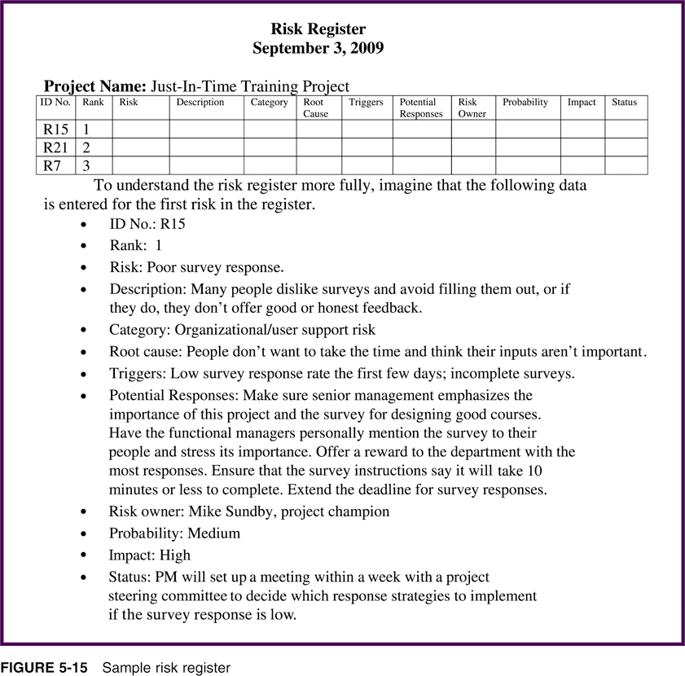
Sample Risk Register

Slide 20
Risk-Related Contract Decisions
Work done by outside suppliers or sellers should be well documented in contracts, which are mutually binding agreements that obligate the seller to provide the specified products or services, and obligate the buyer to pay for them
Project managers should include clauses in contracts to help manage project risks by using:
Incentive or penalty clauses
Certain types of contracts, such as fixed-price contracts, to reduce their risk of incurring higher costs than expected
Competition for supplying goods and services to help reduce negative risks and enhance positive risks on projects

Slide 21
Project Procurement Management
Project procurement management includes acquiring or procuring goods and services for a project from outside the organization
As the business world continues to become more competitive and global, more and more projects include procurement, often referred to as outsourcing
Key outputs include procurement management plans, procurement strategies, bid documents, procurement statements of work, source selection criteria, make-or-buy decisions, independent cost estimates, change requests, project documents updates, and organizational process assets updates

Slide 22
Make-or-Buy Analysis
Make-or-buy analysis involves estimating the internal costs of providing a product or service, and comparing that estimate to the cost of outsourcing
Many organizations also use make-or-buy analysis, often called a lease-or-buy analysis, to decide if they should purchase or lease items for a particular project
Example: Assume you can lease an item you need for a project for $800/day. To purchase the item, the cost is $12,000 plus a daily operational cost of $400/day. How long will it take for the purchase cost to be the same as the lease?

Slide 23
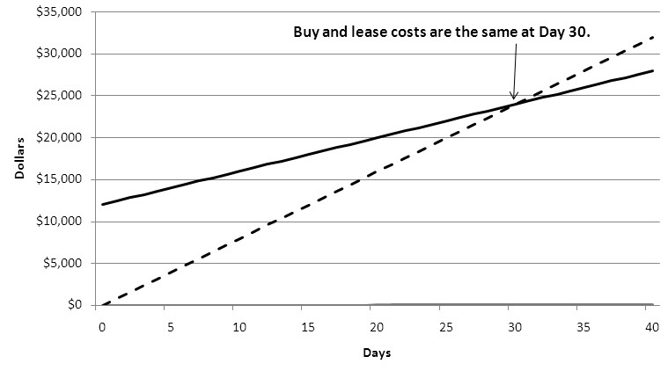
Comparing the Cost of Leasing Versus Buying

Slide 24
Procurement Management Plans
A procurement management plan is a document that describes how the procurement processes will be managed, from developing documentation for making outside purchases or acquisitions to contract closure
Some projects must follow government directives, such as the Federal Acquisition Regulation (FAR), which provides uniform policies for acquisition of supplies and services for executive agencies in the U.S.

Slide 25
Types of Contracts
Fixed-price or lump-sum contracts involve a fixed total price for a well-defined product or service
Cost-reimbursable contracts involve payment to the seller for direct and indirect actual costs
Time-and-material contracts are a hybrid of both fixed-price and cost-reimbursable contracts
Unit pricing can also be used in various types of contracts to require the buyer to pay the supplier a predetermined amount per unit of service

Slide 26
Bid Documents
A Request for Information (RFI) is used when more information about the goods or services is needed. Potential suppliers are asked to provide the information before sending out an RFP or RFQ
A Request for Proposal (RFP) is a document used to solicit proposals from prospective suppliers
A proposal is a document in which sellers describe what they will do to meet the requirements of a buyer
A Request for Quote (RFQ) is a document used to solicit quotes or bids from prospective suppliers
A bid (also called a quote) is a document prepared by sellers providing pricing for standard items that have been clearly defined by the buyer
RFPs are used for procurements where there are a variety of ways to meet a need, while RFQs are used for more standard items

Slide 27
Procurement Statements of Work
A procurement statement of work (SOW) is a description of the work that is to be purchased
It is a type of scope statement that describes the work in sufficient detail to allow prospective suppliers to determine if they are capable of providing the goods and services required and an appropriate price
It should be clear, concise, and as complete as possible, describe all services required, and include performance information, such as the location and timing of the work

Slide 28
Source Selection Criteria and the Supplier Evaluation Matrix
After doing a thorough evaluation of potential suppliers, many organizations summarize evaluations using a supplier evaluation matrix—a type of weighted scoring model
Suppliers are often evaluated on criteria related to cost, quality, technology, past performance, and management

Slide 29
Sample Supplier Evaluation Matrix
Criteria | Weight | Supplier 1 | Supplier 2 | Supplier 3
Past performance | 30% | 70 | 90 | 70
Cost | 25% | 80 | 75 | 70
Educational background | 25% | 70 | 75 | 70
Management Approach | 20% | 85 | 80 | 70
Weighted Scores |  | 75.5 | 80.5 | 70

Slide 30
Quick Review Question

Slide 31
Summary of Main Teaching Points
This chapter summarizes the planning processes and outputs for stakeholder, risk, and procurement management.
Outputs include management plans for each knowledge area, probability/impact matrix, risk response strategies, risk register, risk report, risk-related contract decisions, RFI/RFP/RFQ, procurement strategy, bid documents, procurement statement of work, source selection criteria, make-or-buy decisions, and independent cost estimates.

Slide 32
Question and Answer Session
Q & A

Slide 33
What we will cover next
08 Executing Projects

